Slide 1
Research into CTMSi Portal Solution

Slide 2
Overview
Introduction
Setting the Stage for the Demo
  Portal/Portlet Defined
  How a Portal Solution Could Benefit CTMSi
  Available Open Source Portal Solutions
  Why Liferay
Demo of a Prototype

Slide 3
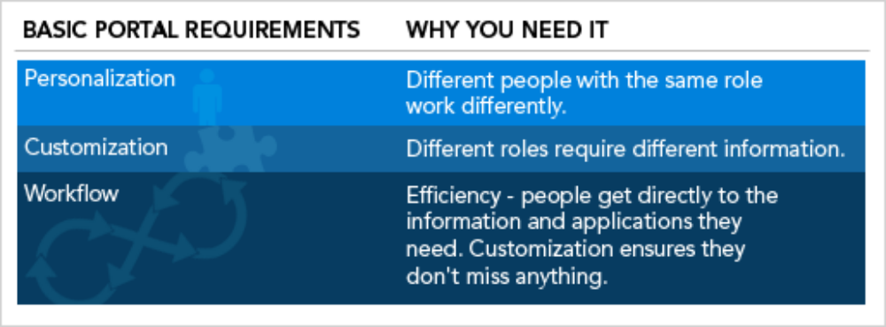
What is a Portal?
Central place for making all types of information accessible to a wide variety of audience
Aggregates content from several sources (Portlets)
Can be accessed via a web browser
Personalizes the presentation for each user or user role
Presents a lot of information in a concise and central way
Integration environment for multiple development efforts

Slide 4
What is a Portlet?
Visual component that can be assimilated into portal web pages
Based on the Java Specification Request (JSR) 168 Portlet Specification
  APIs for Portal computing (aggregation, personalization, presentation, and security)
Deployed in a Portal Containers for accessibility
  Any JSR-168 compliant Portal container
Users can select Portlets of their choice for desktop customization
Are pluggable into any JSR-168 compliant Portal container

Slide 5
Advantages for CTMSi
^{I}
CTMSi is integrating content in the clinical trials workspace.
Integration should be applied to the user interface layer as well
Users can customize their environment by picking portlets that they commonly use. This will enhance user productivity.
Eliminates repetitive development in individual CTMSi application.
  Modules like user authentication and authorization, caBIG/caGrid interaction, web layouts (look and feel, page headers, footers etc), etc. can be provided by the portal.
  Development time can be reduced
As new CTMSi applications are developed, they can be integrated into the portal. Users will immediately be able to interact with them.

Slide 6
CTMSI Portal Requirements
Must be JSR-168 compliant
Must be open source and be deployable in an open source container
Must contain a pluggable authentication framework and allow us to use caGrid security for authentication and authorization
Must provide separate classloaders for different portlets
Must work in Internet Explorer and Firefox
Must be scalable to a large number of portlet deployments and user base
May have the ability to build from source code
May provide additional community developed portlets and themes
May be easy to install, configure and administer
May provide robust support for development and deployment

Slide 7
Portal Containers
Portal Containers that met our requirements were
  JBoss Portal (http://www.jboss.org/products/jbossportal)
  Gridsphere (http://www.gridsphere.org)
  Liferay (http://www.liferay.com)
We created prototypes on all three.
All three are mature products and did not have any major shortcomings.
We chose Liferay

Slide 8
Why Liferay?
Mature platform which has been in production for 8 years.
Exceeded our requirements. Had the most number of features of any open-source portal we evaluated.
Excellent User Interface, documentation and community support
Did not have any vendor dependencies
Supports most Operating system and application servers
Pre-built for most major platforms
Excellent integration with ServiceMix ESB

